Slide 1
Classification for Housing Loans
Selling Your Home
Presented by
Naif Alsulaihem
Nasser Alshehri

Slide 2
Outlines
Outlines
Summary
Data Description
Introduction
Experiments
Problem Statement

Slide 3
Outlines
Introduction
Housing is one of the necessities of life that must be owned. Our company provides a financing service for people to obtain housing. And the agreement with the customer to pay this amount in installments within a specified period of time

Slide 4
Problem Statement
We face the problem of defaulting on some customers' payments, which makes us form a team to analyze customers and find out who will default, and this is very difficult, so we will do this process by learning the machine and trying to predict through data of customer.

Slide 5
Data Description
The data is customer data such as gender, marital status and education..
The data was extracted from Kaggle and it contains 13 columns and 615 rows.

Slide 6
Experiments
Baseline | train | 0.76
 | val | 0.76
Decision Tree | Train | 0.814
 | Val | 0.756
Random Forest | Train | 0.808
 | Val | 0.813
Knn | Train | 0.812
 | Val | 0.813
Logistic Regression | train | 0.816
 | val | 0.814
Naïve Bayes | train | 0.794
 | val | 0.812
SVM | train | 0.688
 | val | 0.699

Slide 7
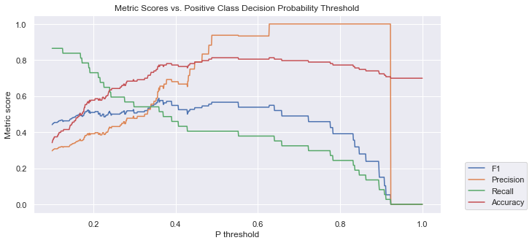
Outlines
Experiments - Logistic Regression
F 1
0.56
Precision
0.93
Recall
0.40
Train
0.816
Test
0.813

Slide 8
Summary
i
We have used many algorithms to predict the loan status
The highest rated algorithm is Logistic Regression

Slide 9
Thank You

